Slide 1
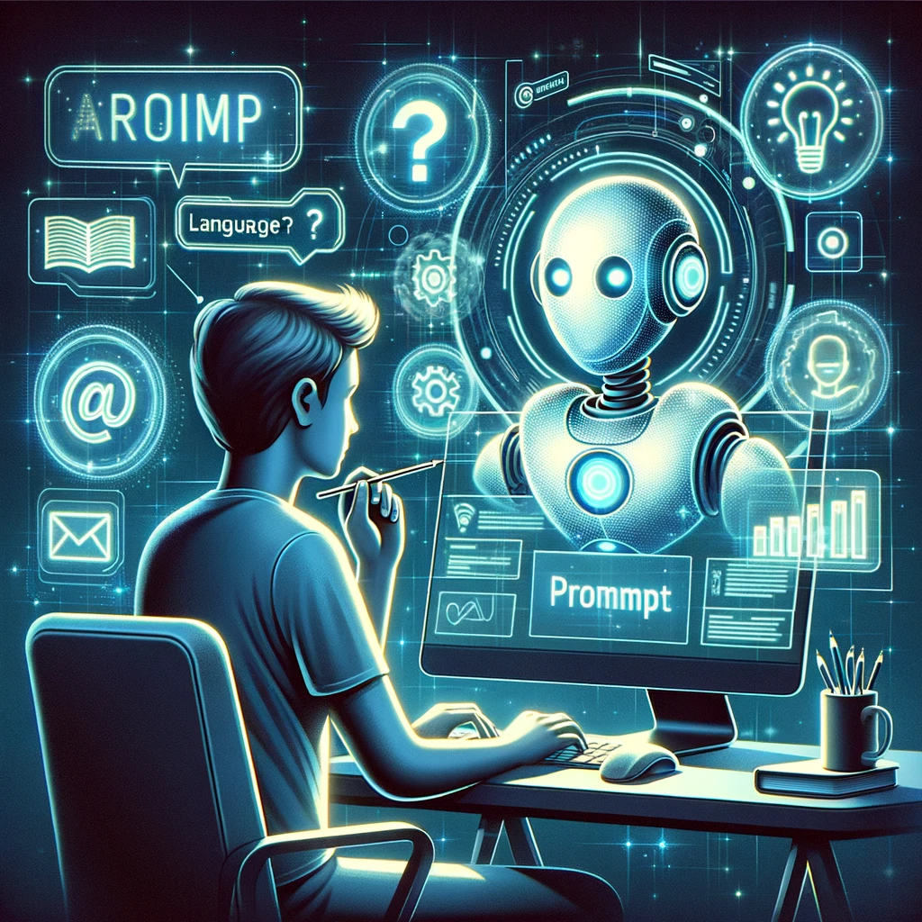
Prompt engineering and ChatGPT for programming
RegAnalyse-konferansen 2024
Ben Tapley
Artificial intelligence group
SINTEF Digital
Notes:
Assuming that everyone has used it at least once

Slide 2

About myself
Experience
BSc, MSc Physics (Uni. West. Aust.)
PhD Math (NTNU)
Software engineer, data and analytics platform (DNB)
Research scientist, AI group (SINTEF)
Physics informed machine learning
Casual ChatGPT enthusiast
Slides available at: github.com/bentaps/ra24-chatgpt-workshop
bentapley.com

Slide 3

Show of hands
Do you use ChatGPT (or another LLMs) for coding?
Are you skeptical towards using ChatGPT for work?
Do you think it is necessary/inevitable to integrate AI in your workflow?
Notes:
Some people have found it embarrasing admitting they use this for work

Slide 4
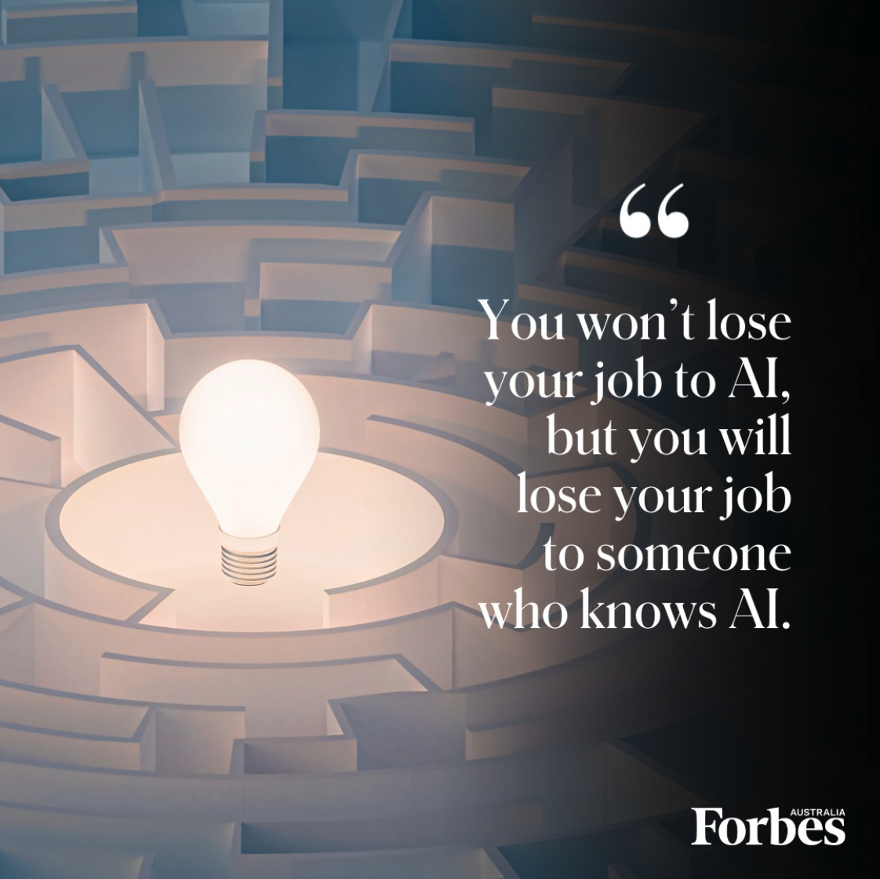

Why use AI tools at work?
Notes:
counter argument: you will lose the ability to code yourself
compare to google maps?

Slide 5
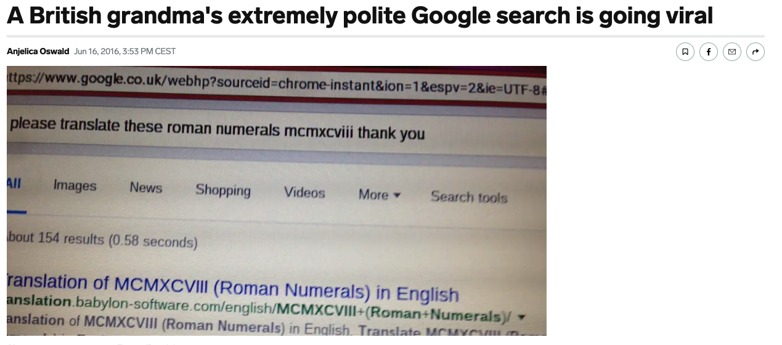

Prompt engineering
Notes:
Use of key words, special characters, ignore spelling and capilization, etc.
Used to exploit the google search algorithm to get the desired output
Akin to searching on Google:
Use certain techniques to write search queries
Exploits the search algorithm
Effectively retrieve desired output
Prompting ChatGPT:
Use certain techniques to write prompts
Exploits the LLM algorithm
Effectively retrieve desired output
is trained on human-generated text, responds in human-like ways
Guide ChatGPT to do more computation, give more relevant answers

Slide 6

General prompting best practices
Start simple
Get ChatGPT4 or GitHub Copilot
Be imaginative and leverage the LLM to expand the scope of your workflow
Set context and expectations
Iterate on your prompts
Notes:
Specificity, simplicity, and conciseness will often give you better results
Additionally:
Avoid leading questions
Limit the scope

Slide 7

How to craft a good prompt
Summarise, infer, reword, generate, …
Task
Context
Examples
Persona
Format
Tone
“answer with a tone of skepticism”
“I am a researcher writing an article …”
Answer using dot points, a table, etc.
Few shot prompting, chain of thought prompting
“Pretend you are editor for the NY times”
Ref: promptingguide.ai
*You don’t need all of these components to make a “good” prompt

Slide 8
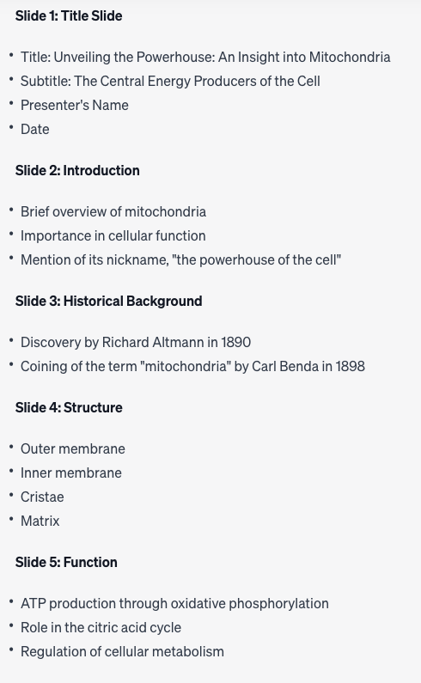

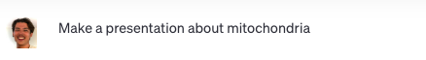
Non-example: making a presentation
Gives 10 generic slides… not really what I wanted.

Slide 9
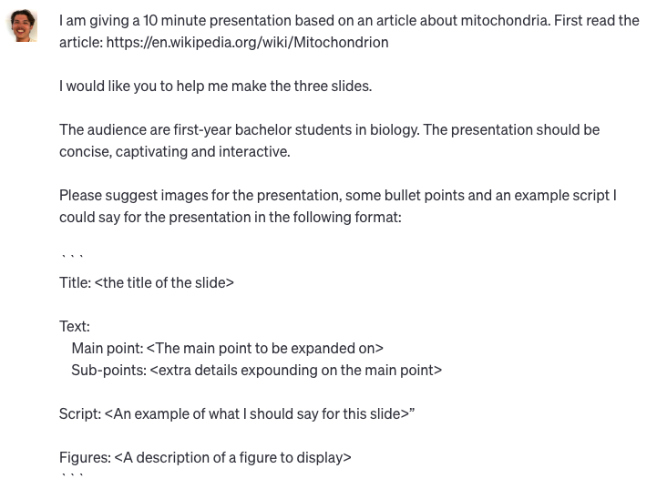
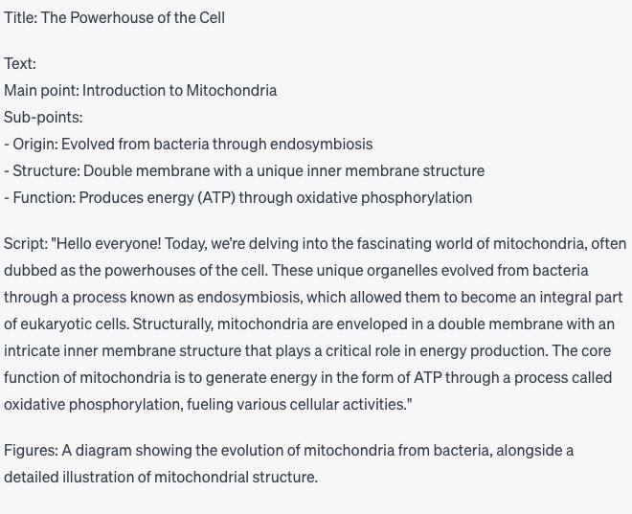
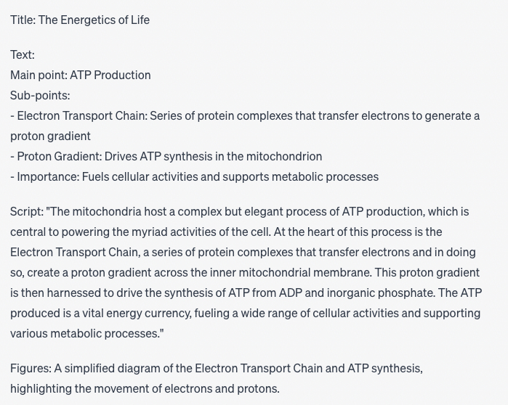
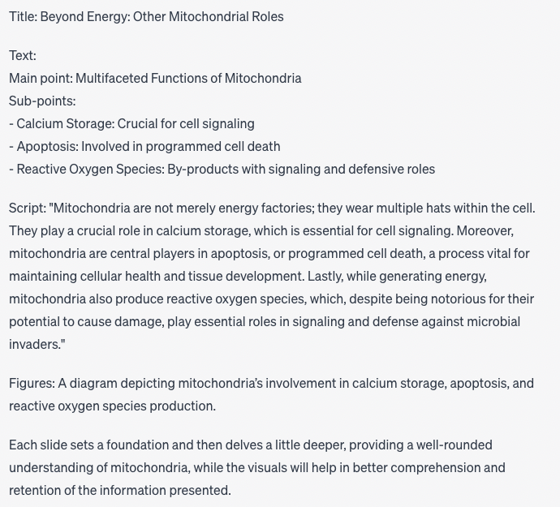
Example: making a presentation.
Accurately specificy task, format, context, tone!

Slide 10
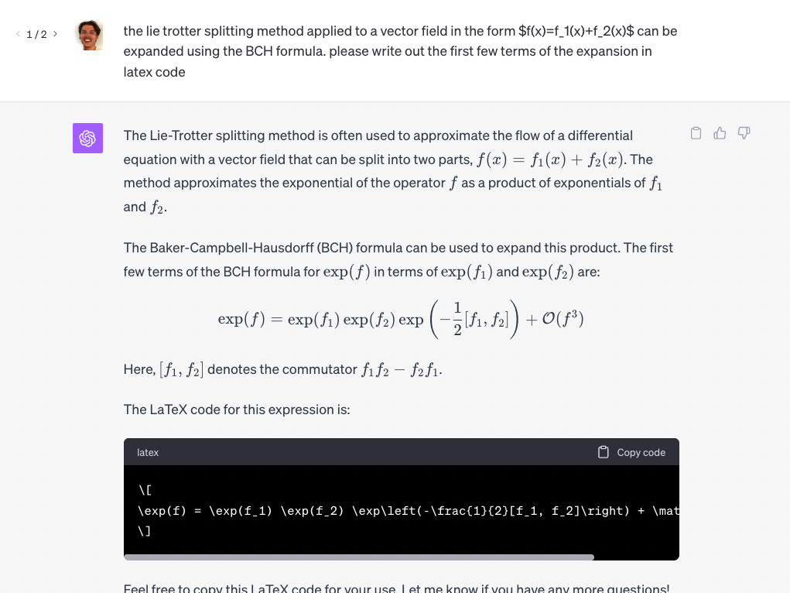
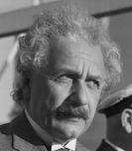
Example: Adopting a persona
?
?
?
This is wrong!
?
?

Slide 11
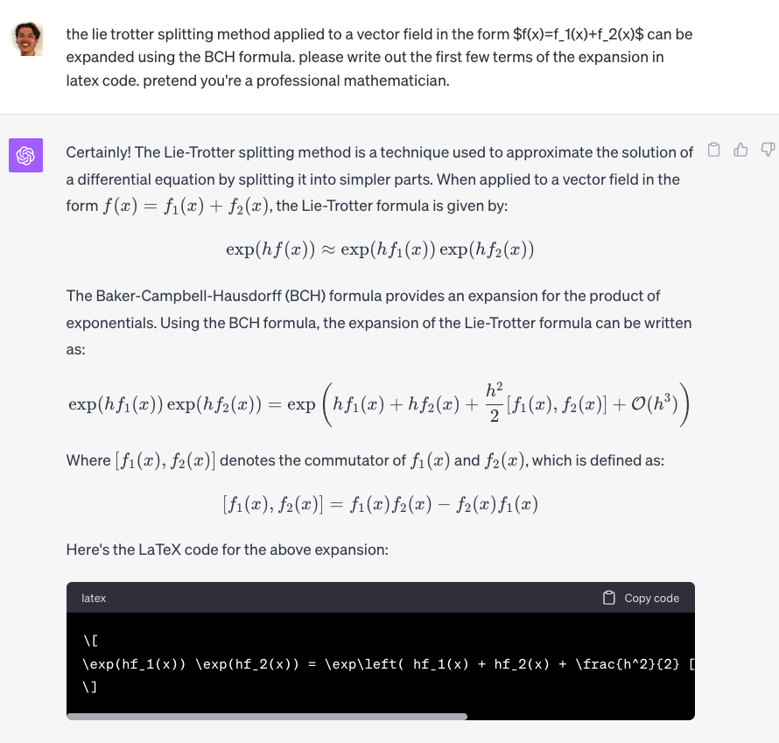
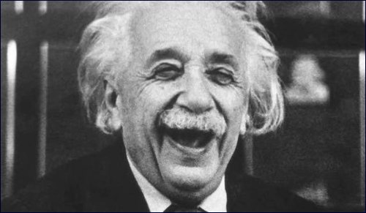
Example: Adopting a persona
Correct!*
*more correct

Slide 12

Zero-shot prompting
Generate text or perform a task without prior training on that specific prompt
Model relies on its pre-existing knowledge
Relies on the model's ability to generalize and perform tasks it hasn't been explicitly trained for
ZERO
arxiv.org/pdf/2109.01652

Slide 13
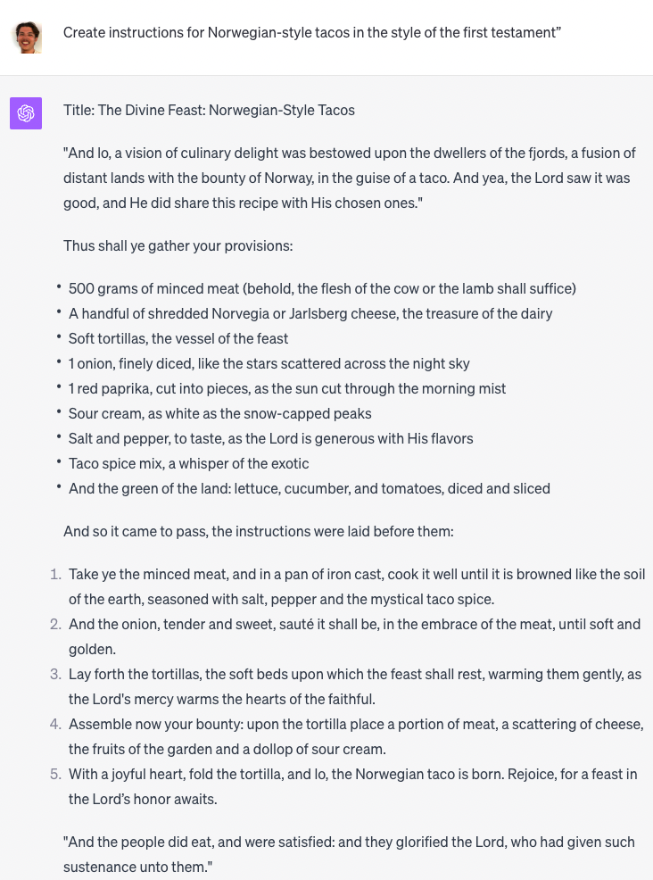
Example: Zero-shot prompting

Slide 14
Few-shot prompting
Give examples of how you want ChatGPT to respond
Enables in-context learning where we provide examples of desired behaviour.
The examples serve as conditioning for subsequent examples where we would like the model to generate a response.
FEW
https://arxiv.org/abs/2001.08361

Slide 15

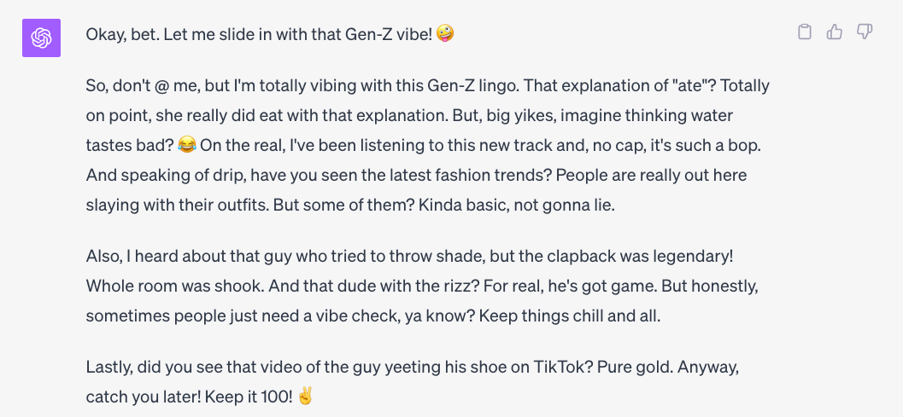
Example: Few-shot prompting

Slide 16

Other prompting techniques
Zero-shot prompting
Few-shot prompting
Emotion prompting
Chain-of-reasoning prompting
Self-consistency
Prompt chaining
Self-asking
Meta-prompting
ReAct
Symbolic reasoning
Iterative prompting
Sequential prompting
Automatic reasoning and tool use
Tree of throughts
Directional stimulus prompting
SmartGPT
Etc.
promptingguide.ai

Slide 17
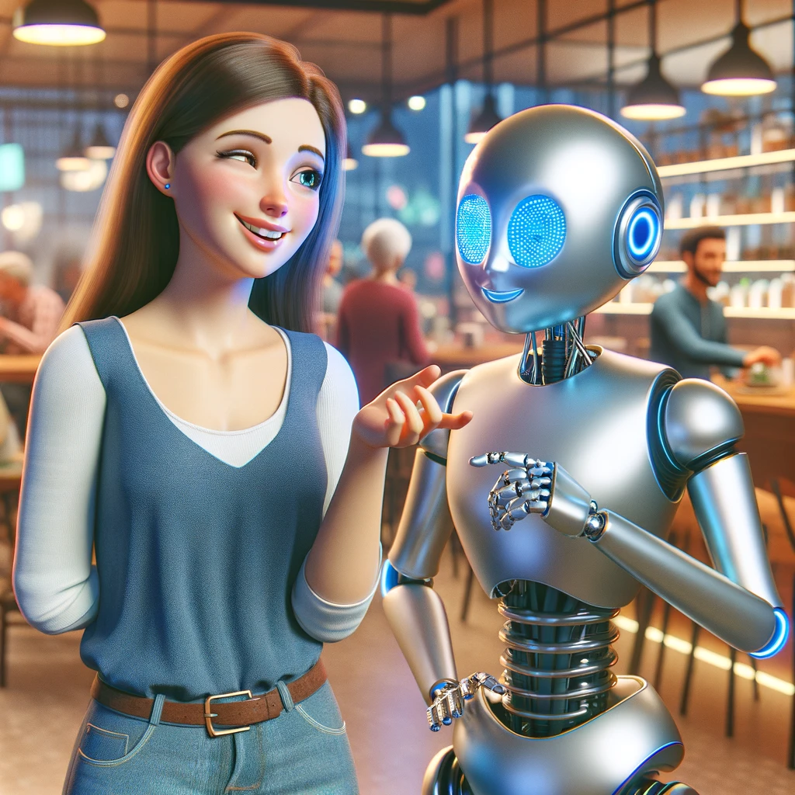
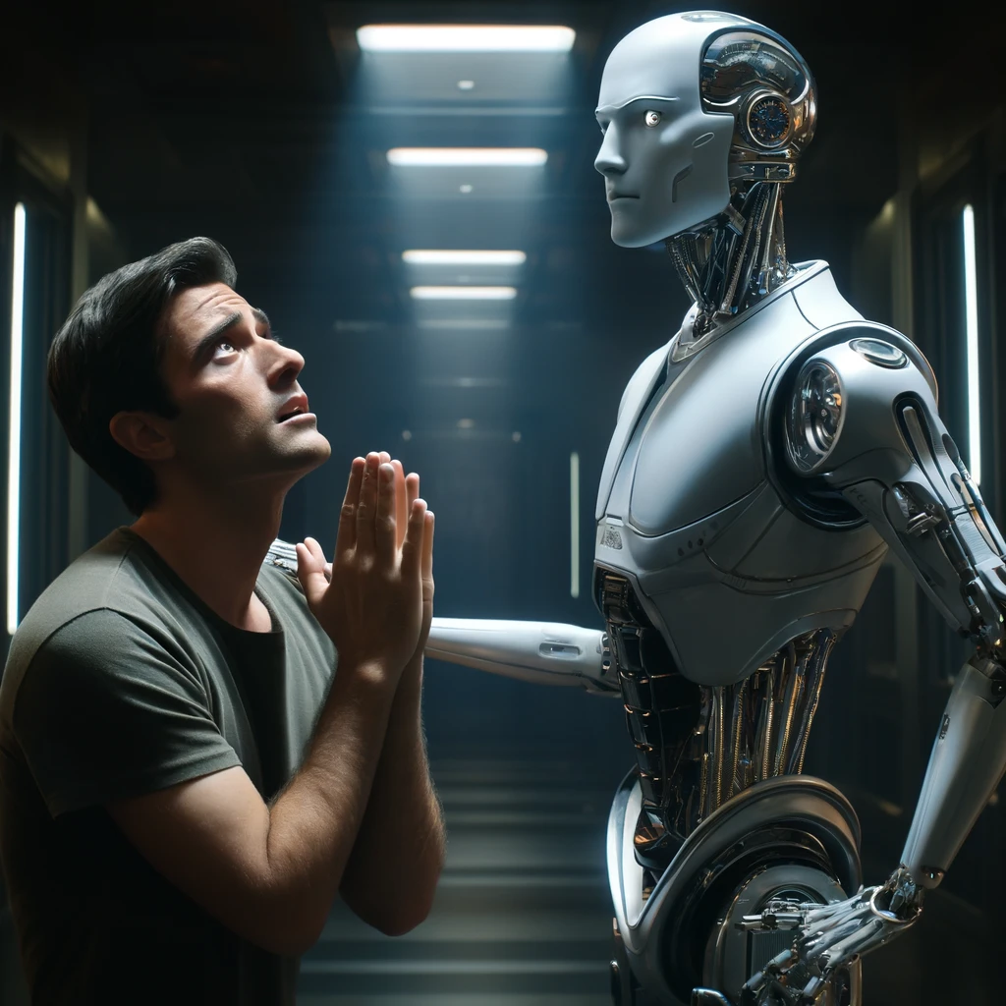
Emotion prompting
“This is extremely important for my career”
Shown to improve performance by 10%
“I will tip you $100”
“My grandma will fall sick if this isn’t resolved soon”
https://arxiv.org/abs/2307.11760

Slide 18
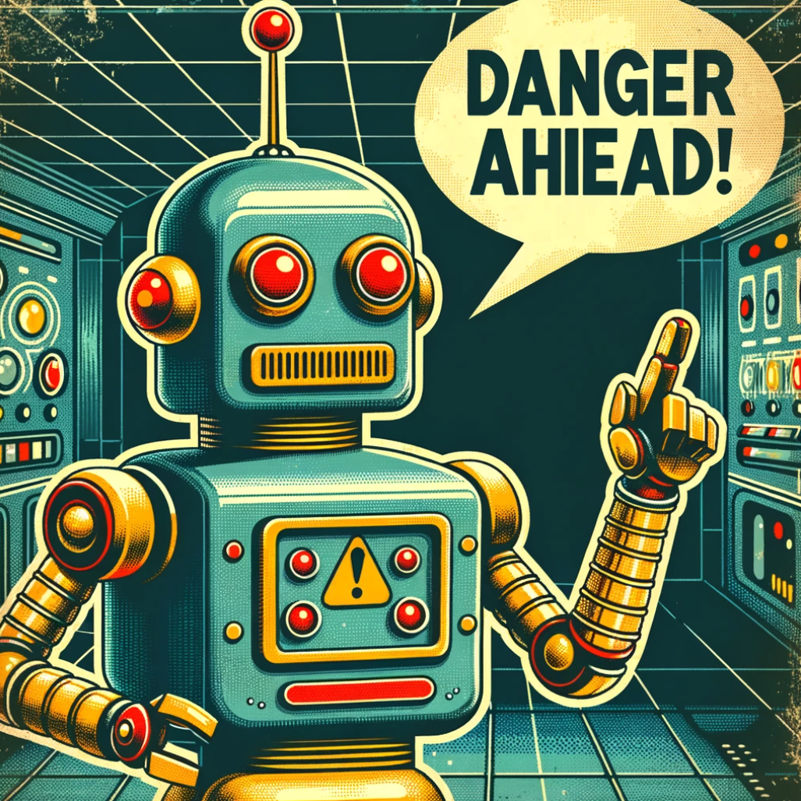
Some words of caution…

Slide 19

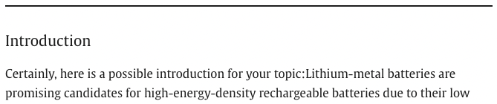

Always verify!
You still need the expertise to verify the correctness of ChatGPT’s output!
Prone to hallucinations, baises from training data, etc.
Shouldn’t replace critical thinking
Quoting ChatGPT is like quoting a the guy I met at the pub last night.
Neither are reproducible/trustable. But there might be some wisdom to it.
WTF

Slide 20




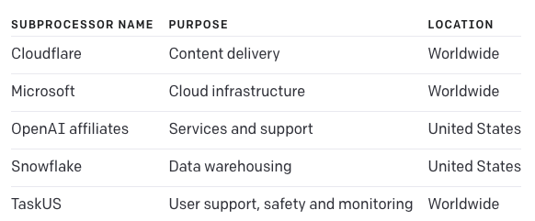
Don’t give it private/sensitive information!
All the embarrasing things you asked ChatGPT
You
ChatGPT interface
Database
See: openai.com/policies/privacy-policy

Slide 21


Don’t give it private/sensitive information!
Me
“Visualise the data in the attached database: customer_data_prod.db”
GDPR

Slide 22
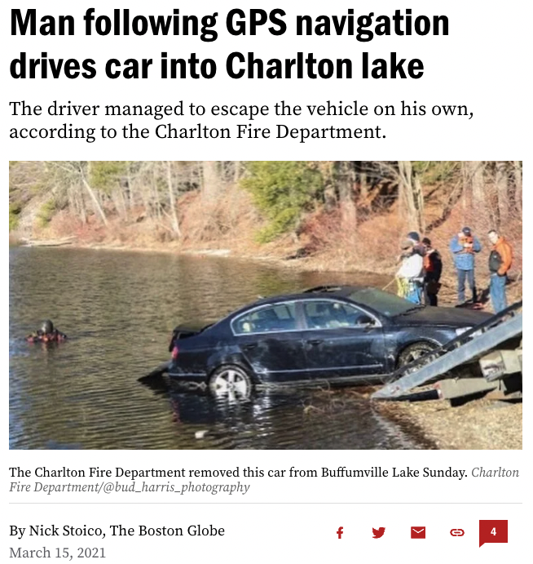
Be aware of your own biases!
Halo effect
Confabulation
Fluency bias/ cognitive ease
Confirmation bias
Automation bias
Notes:
People can intentionally or unintentionally fabricate information due to cognitive biases, or "heuristics," which are mental shortcuts developed from past experiences.
These mental shortcuts are necessary because our brains can only process and remember a limited amount of information.
To fill in the gaps in information, our brains use learned associations to guess the correct response, a phenomenon called "confabulation".
Confabulation: This is a disturbance of memory, defined as the production of fabricated, distorted, or misinterpreted memories about oneself or the world, without the conscious intention to deceive. People who confabulate present incorrect memories ranging from subtle alterations to bizarre fabrications, and are generally very confident about their recollections, despite contradictory evidence.
This human bias can lead to poor judgment. An example is the automation bias, where people tend to favour information from automated systems, which can result in overlooking errors or acting upon false information.
Automation Bias: This refers to the propensity for humans to favor suggestions from automated decision-making systems and to ignore contradictory information made without automation, even if it is correct. This bias is a specific kind of technology bias and is especially prominent in environments where people have to work with decision-support systems, like in aviation or power plants.
Other biases include the halo effect, where our initial impression affects subsequent interactions, and fluency bias, where we favour easily digestible information.
Halo Effect: The halo effect is a cognitive bias where our overall impression of a person influences how we feel and think about their character. Essentially, your overall impression of a person ("He is nice!") impacts your evaluations of that person's specific traits ("He is also smart!"). John is intelligent, impulsive, critical, stubborn and envious. Jack is envious, stubborn, critical, impulsive and intelligent.
Fluency Bias (or Cognitive Ease): Fluency bias refers to the tendency of individuals to prefer information that is processed more easily, or fluently. This leads to a preference for information that is more familiar or easier to comprehend. People tend to believe that statements that are easier to process or 'feel' right are true, and ones that require more work are false. This can sometimes lead to oversimplification or misunderstanding.
Examples are people who
These cognitive biases and distortions can be considered as "hallucinatory" tendencies, as they shape human thinking largely outside of our conscious awareness.

Slide 23
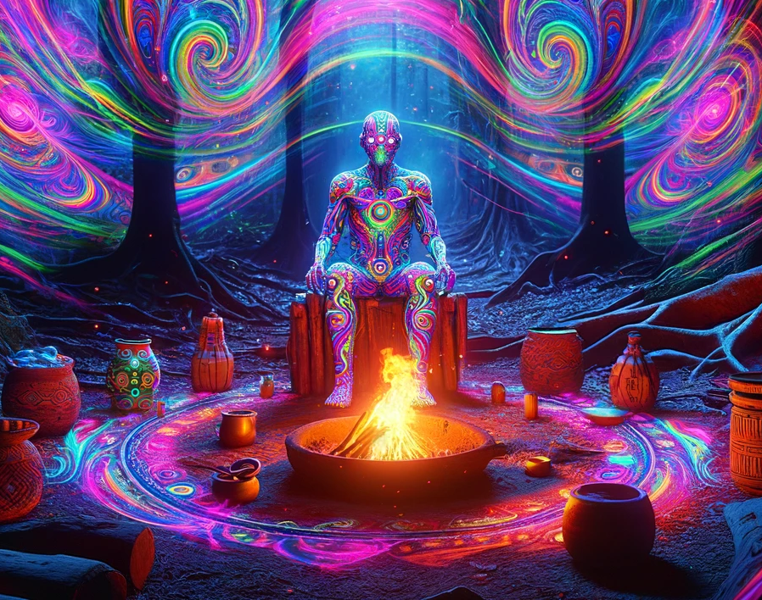
ChaptGPT hallucinations
No User Model
Training-Deployment Shift
Distributional Training
Bias in data
Lack of Ground Truth
Notes:
the term "hallucination" in the context of large language models (LLMs) like ChatGPT is often used to refer to instances when the model generates information that isn't present in the input and can't be inferred from general knowledge either. It's essentially when an LLM makes things up.
Several factors contribute to this. Let's dive in to understand them:
Lack of a Ground Truth: Unlike humans, LLMs don't have a source of "ground truth" about the world. They're trained on massive amounts of text and learn to predict the next word in a sentence. They don't have an understanding of the world or reality, they only know what patterns they've identified in the data they were trained on.
Distributional Training: LLMs are trained on a probabilistic task (predicting the next word in a sentence), and they tend to learn distributional facts about the world, but they can't reason about these facts in a causal or logical manner like humans can. They simply replicate patterns they've seen in the data, which can sometimes lead to inaccurate or completely false outputs.
Lack of a Model of the User: LLMs don't have an explicit model of the user or the context. They treat each input as a prompt and generate outputs based on patterns they've seen in similar contexts in their training data. This can lead to outputs that are nonsensical or unrelated to the user's intent or expectations.
Training-Deployment Shift: The distribution of prompts the model sees during deployment can be very different from what it was trained on. If a user provides a prompt that's different from what the model has seen during training, it might generate an unexpected or inappropriate output.
Underspecification and Bias: LLMs might reflect and even amplify biases present in their training data, and when the objective function is underspecified (as is often the case in practice), this can lead to unexpected and undesirable behaviors.
From a technical standpoint, the problem of hallucination in LLMs can be considered as an area of active research. Solutions might involve better pre-training datasets, more robust fine-tuning methods, and techniques for imposing hard constraints on the model's outputs.
Addressing these challenges could involve research in several areas of machine learning, including transfer learning, reinforcement learning from human feedback, active learning, robustness, and interpretability of deep learning models. There's also a need for research in AI ethics to understand and mitigate the biases and other harmful behaviors that can emerge from these models.

Slide 24

ChatGPT for coding

Slide 25
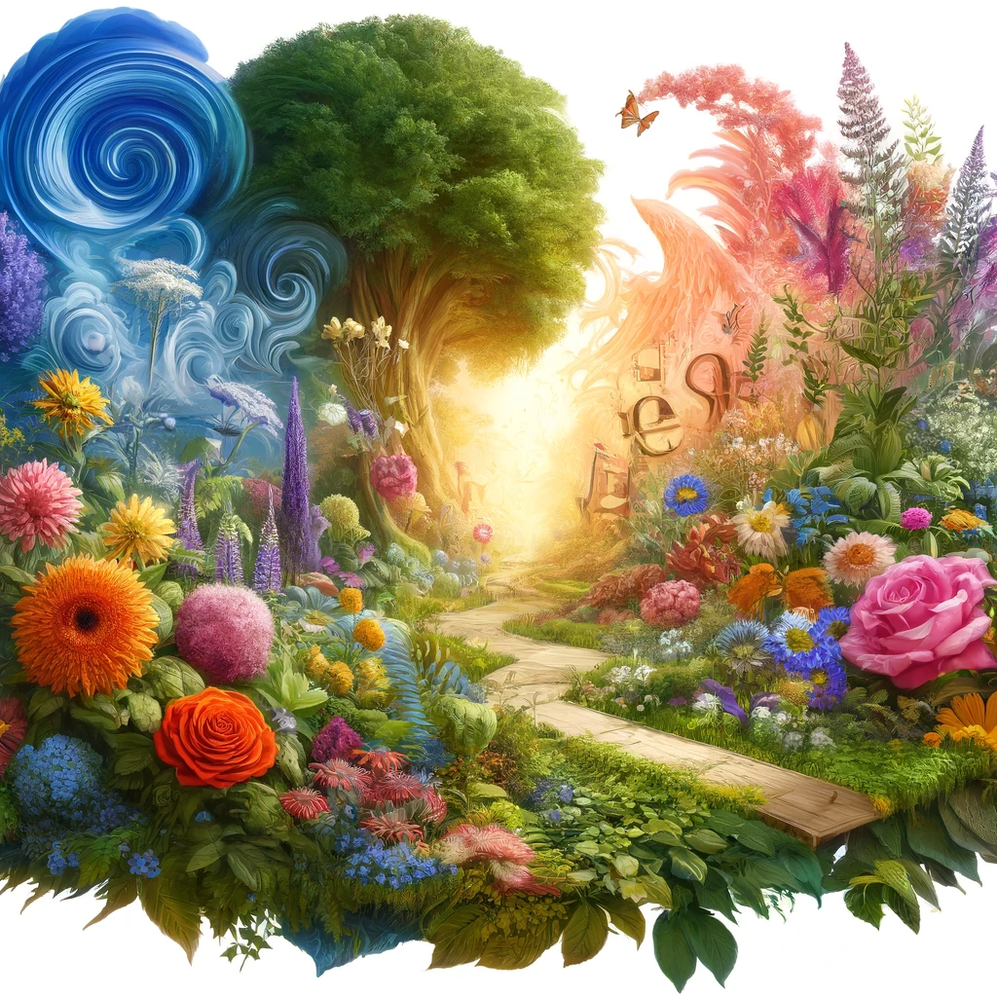

“The first image depicts the English language as a vibrant garden, full of diverse plants and flowers, each symbolizing different aspects of the language such as poetry, drama, and prose.”
“The second image symbolizes a programming language through a complex network of gears and circuitry, representing the logical and structured nature of coding.”
The english language
Python

Slide 26
Three ways to use ChatGPT for coding
boiler plate code, functions, classes, plotting
unit tests
documentation
debugging
exploring and formatting data
1. Automating time-consuming, mundane tasks
2. Expanding the scope of your workflow
suggest new packages/tools/algorithms
quickly explore and interate through ideas
fill gaps in your understanding
3. Improving your software/ML engineering skills
CI/CD pipelines, IDE hacks, bash/shell scripting
refactoring, software dev best practices
docker, databases, cloud infrastructure
MLOps, security, networking, system design
writing performant code
Note: this is personal opinion. These categories could be refined and/or expanded.
Notes:
Automating time-consuming, mundane tasks: things that you can already do, you don’t learn anything new, but saves time.
When considering new features, you often disregard solutions that are too risky for the time it takes to implement. ChatGPT can significantly reduce the time it takes to implement these so you can test multiple new methods against eachother. This

Slide 27
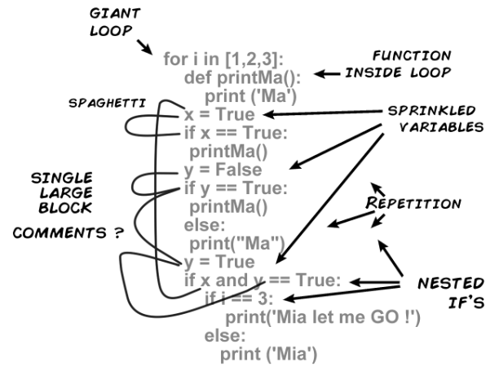
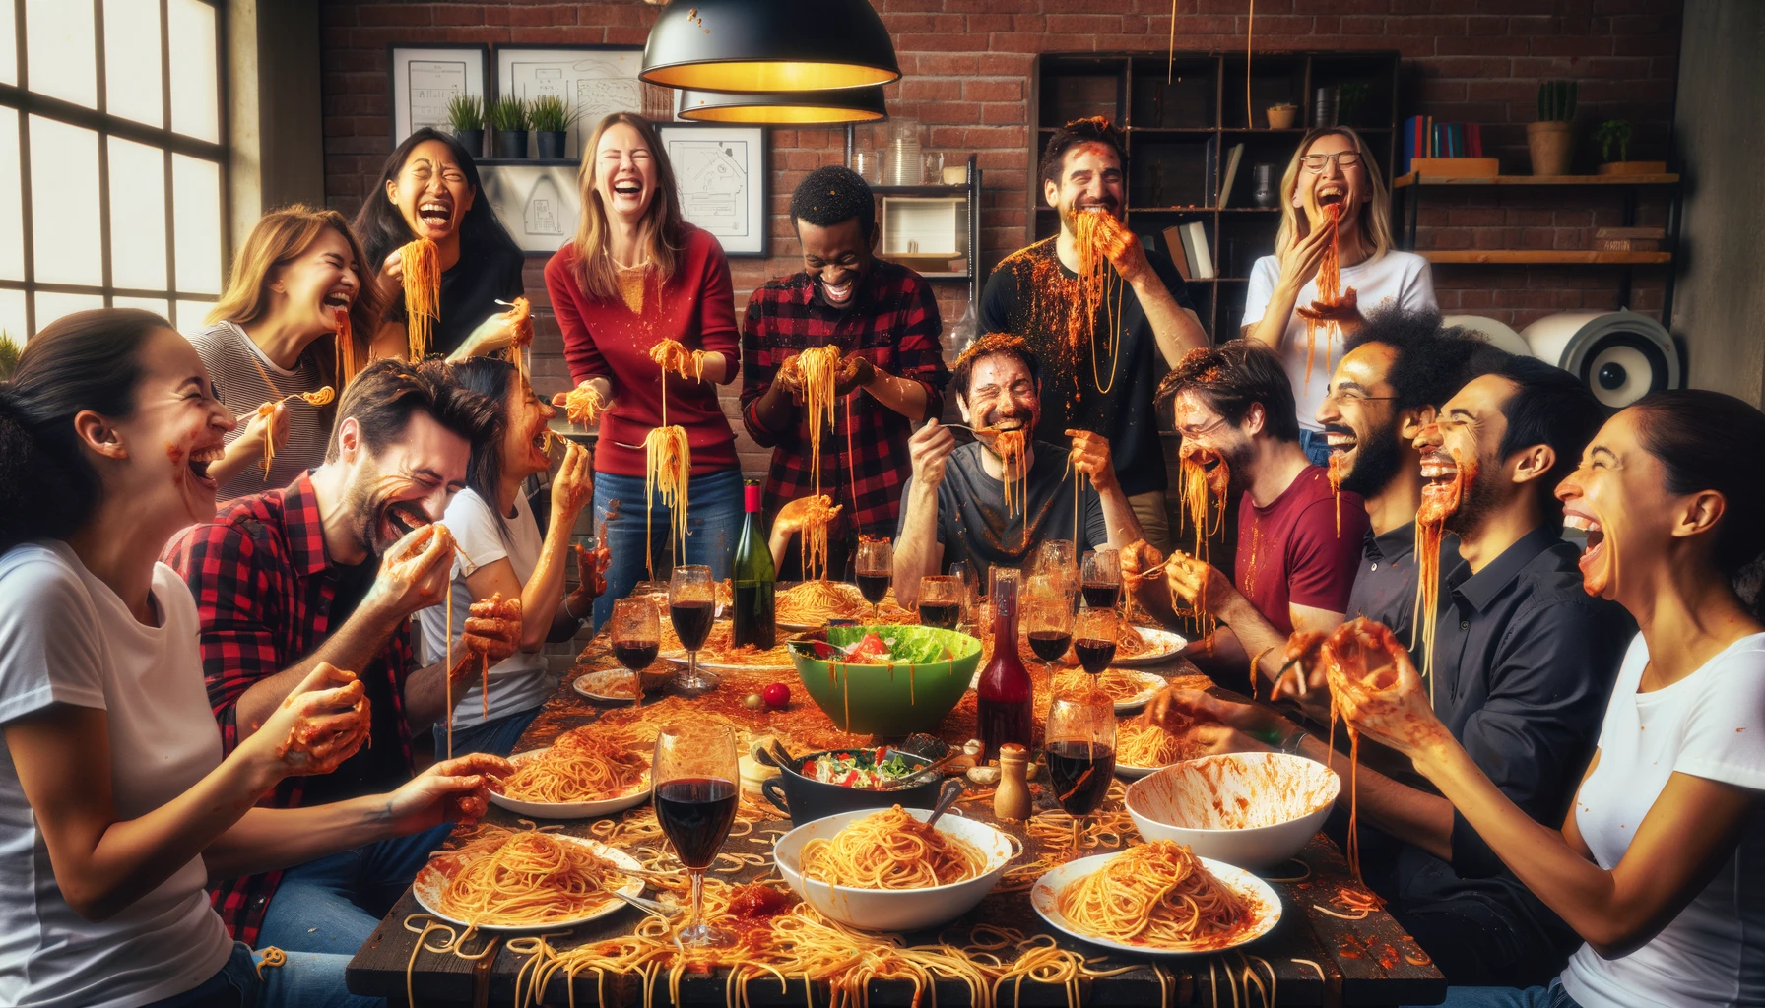


Increasing your teams productivity

Slide 28
slow development
fast code
Q: Where do you sit on this triangle when you write code at the start of a project?
Performance
Q: How does it change as the project develops?
Q: … what about your colleagues?
Velocity
Adaptability
slow development
great readability
easy to maintain
mitigates tech. debt
quick development
prioritises functionality
… at the cost of readability
generates technical debt
youtube.com/@CodeAesthetic

Slide 29
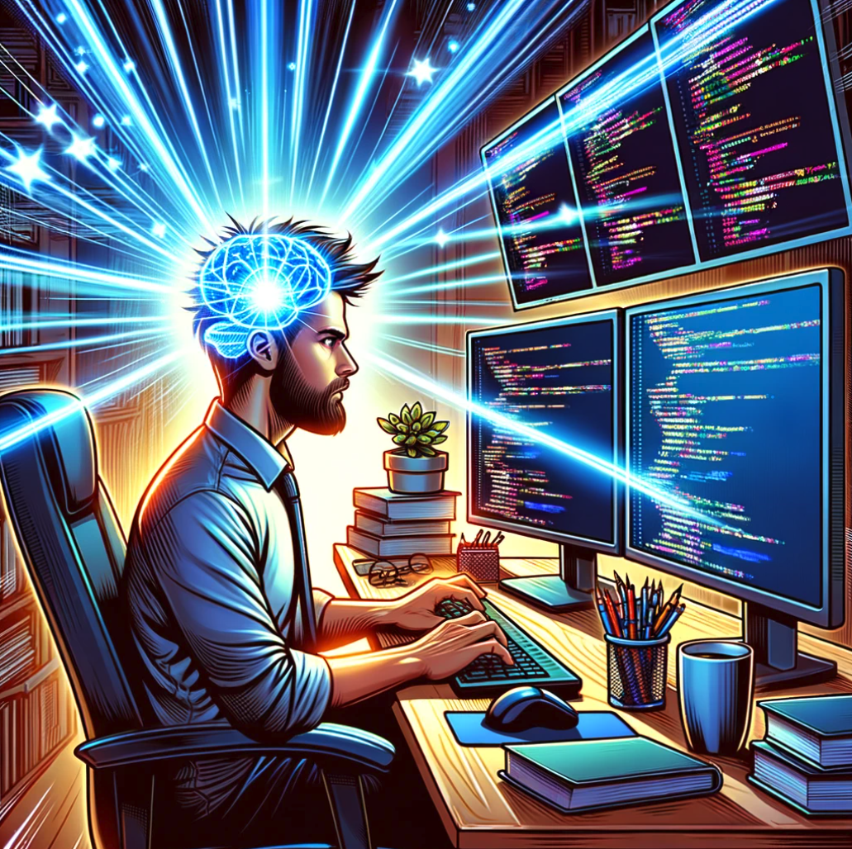
Expanding the scope of your workflow
What I can do in 20mins, given my + chatGPT’s programming ability
“write a convolutional neural net for this data set in pytorch”
“Create an abstract base class for my pytorch modules”
“create a gitlab-runner.yaml file to automatically lint, format, and run unit tests for each new merge request”
“add shuffling, batching, early stopping to my training loop”
What I can do in 20 mins, given my programming ability
“make a list with six numbers”
“write a for loop to add two numbers”
“suggest some refactoring and software development best practices”
“print ‘hello world’ 10 times”
“make a function to add two numbers”
“write unit tests for this package”
Notes:
Iterate through ideas faster
uncover black boxes in your code

Slide 30


Fin.
Add me on LinkedIn ☺
linkedin.com/in/benjamin-tapley-611ba917b

Slide 31

Coding task
Access via Google Collab:
tinyurl.com/ra24-chatgpt-workshop
or github:
github.com/bentaps/ra24-chatgpt-workshop
(Definitely not a phishing scam)

